Slide 1
What is Linux?
Computer operating system
  Open-source operating system modeled after UNIX.
Why Linux?
  Multi-user platform
  Powerful Computing Resource
  Popular in Scientific Research

Slide 2
Getting Started with LINUX
Choose a System
  Each server has a “hostname”
  login, pegasus, enterprise, mars, yucatan, titan (.coaps.fsu.edu)
Login to the system
  ssh -Y user@system
  Enter your COAPS username & password
  NOTE: This is different from your FSUID and is not linked!

Slide 3
CHANGING YOUR LINUX PASSWORD
yppasswd
Bad choices for passwords:
  Avoid words in any dictionary, or any prefix, suffix, etc. of such a word. Also, any concatenation of two or more such words.
  Any personal information. For example: social security number, names of relatives, friends, significant others. Names of pets. Make, model, license plate number of a vehicle, etc.
  Any password that someone has suggested to you or that you've seen written down.
  Any sequence of adjacent keys on the keyboard. For example, ”qwerty".
Updates take several hours to propagate to all systems

Slide 4
A good Password MUST:
Contain a mix of
  Lowercase Alphabetical (a, b, c, etc.)
  Uppercase Alphabetical (A, B, C, etc.)
  Numbers (0-9)
  Special Characters (@, %, !, etc.)
Above group must all be represented in 1st eight characters of your password

Slide 5
Passwordless Login is Strongly Recommended
On local Terminal run the command ssh-keygen
  enter,enter,enter…until done
cat ~/.ssh/id_rsa.pub
  Copy string to your clipboard
On remote host append the string contents to ~/.ssh/authorized_keys
  cat >> ~/.ssh/authorized_keys
  Paste clipboard contents
  Control + D to end cat input
Ensure authorized_keys has proper permissions
  chmod 600 ~/.ssh/authorized_keys
OR use “ssh-copy-id user@remotehost”

Slide 6
Connecting Remotely
Use the login server for external ssh access (use vpn.fsu.edu when possible)
  (via non-FSU source addresses)
login.coaps.fsu.edu
Once connected you may connect to any other COAPS server*
  e.g., ssh –Y bfs-v11-yucatan

Slide 7
Enabling Graphical
X11 Forwarding
On PC / Windows
Use MobaXterm (easier to use)
OR
Putty
  Check Enable X11 Forwarding
Putty > Connection > SSH > X11
  Run Xming (add to shell:startup)
Advanced Tip: add the “coaps.fsu.edu” search domain to your network settings to save yourself keystrokes

Slide 8
Enabling Graphical
X11 Forwarding
On macOS
Use the Terminal Application
ssh -Y user@system
add the “coaps.fsu.edu” search domain to your network setting to save yourself keystrokes (i.e., auto-completion/search of the domain name)

Slide 9
Running X11 Apps Remotely
(legacy option, phasing out)
On PC
Use NoMachine (NX)
  Legacy Client Only
  Disable Check for Updates
    do not update
  http://coaps.fsu.edu/~mcdonald/software/nxclient.exe
NX is only supported on the following legacy compute nodes
  nx, pegasus, enterprise

Slide 10
Linux Commands
Basic Form:
command [-options/flags] [arguments]

Slide 11
Essential Linux Commands
ls
  List the contents of a directory
cd directory
  Change directory
cp fileA fileB
  Copy a file/directory
mv fileA fileB
  Move a file/directory.
exit
  Exit the system (Ctrl + D)
lp filename.ps
  Print file
mkdir dirname
  Make directory
df .
  Check disk space
rm file
  Remove file
man command
  Manual for each command

Slide 12
Additional Linux Commands
cat
  Dump or Concatenate file(s)
whoami
  Prints current username
top
  Real time display of processes
atop
  Advanced system dashboard
alias
  List / Create shortcuts for commands

Slide 13
Your Home Directory
~/
~username
Your pwd when you log into any system.
  Your environment setup files and other files are stored here.
Each user has only one home directory. No matter which system, the user accesses the same home directory.
A place to store important documentation, programs, etc.
Data in your home directory is backed up daily!

Slide 14
COAPS Compute Nodes
Fedora Core (latest OS and software, e.g., python3)
  {mars, yucatan}.coaps.fsu.edu
    Each have 512GB RAM, 96 cores, Matlab, compilers.
RHEL 6 (legacy EoL computing applications)
  {enterprise, pegasus}.coaps.fsu.edu
    Each have 256GB RAM, 64 cores , legacy Matlab, compilers.
Dedicated Resources for Groups/Applications
  skynet (GPU Computations)
  titan (Mark Bourassa Group)
  monsoon, elninio (Vasu Misra Group)
  samos-*, mdc-* (Shawn Smith)
Remote off-campus SSH Access w/o VPN privileges
  SSH Gateway / “jump host” = login.coaps.fsu.edu

Slide 15
Friendly Computing
Resources: Storage, Memory, CPUs
Shared Disk Storage:
Periodically clean up disk allocations
  Remove any old / never used / data folders / etc.
Shared CPU / RAM:
run large (long running) jobs off peak hours
release memory when a job finishes
  Quit Applications: Matlab, idl, etc. when not in use!
Do not over-parallelize programs
  total CPU/core count * .90 = max || processes
  i.e., reserve 10% for system processing overhead

Slide 16
Check DISK Storage
df -hP
report file system disk space usage
For current directory
df –hP .
df -hP
Filesystem Size Used Avail Use% Mounted on
/dev/sda3 42G 8.8G 31G 23% /
tmpfs 64G 120K 64G 1% /dev/shm
/dev/sda1 976M 109M 816M 12% /boot

Slide 17
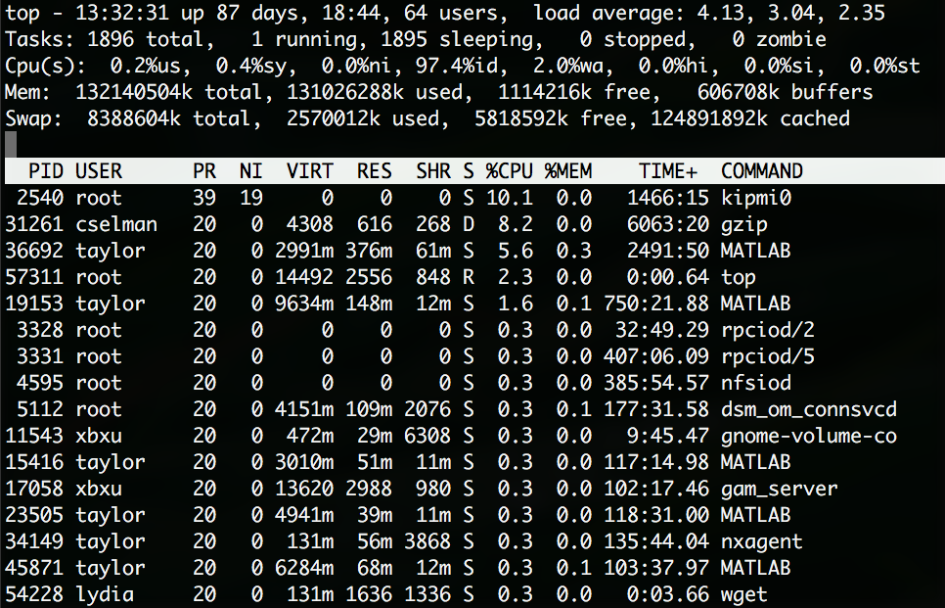
Check System CPU/MEM LOAD
top : display Linux tasks
  Also see: htop, atop, glances

Slide 18
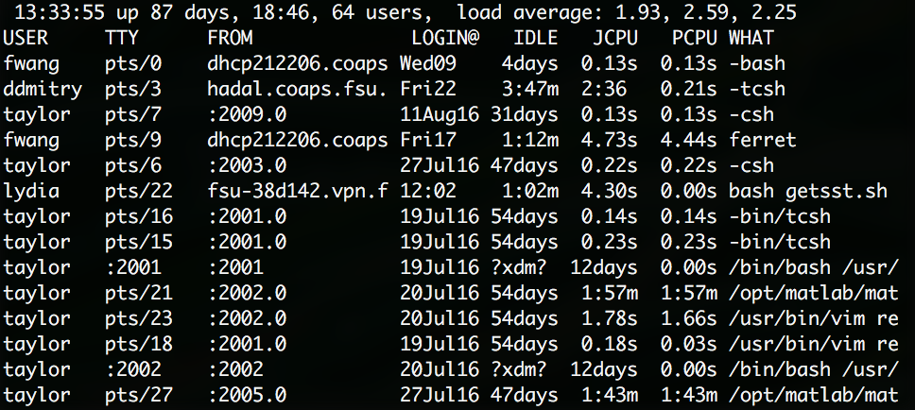
Check WHO IS LOGGED IN
w - Show who is logged on and what they are doing.

Slide 19
Advanced LINUX Commands
find path [expression]
diff file1 file2
meld
Google Is Your Friend. Use Google first (ChatGPT or equivalent can do wonders), research the problem (1/2 a day), and then email help@coaps.fsu.edu if you are still stuck.

Slide 20
Editors
Linux Graphical Editors
nedit
emacs
bluefish
Linux Command Line Editors
vi
nano

Slide 21
Customizing Your Environment
/bin/bash shell
  ~/.bash_profile
  ~/.bashrc
  ~/.login
  ~/.logout
  etc.
Bash is the Default & Preferred Shell
/bin/tcsh shell
  ~/.cshrc
  ~/.login
  ~/.logout
  etc.

Slide 22
CODE Documentation
https://wiki.coaps.fsu.edu
  COAPS’ NIS/YP user and pass Authentication
Contact Help
  help@coaps.fsu.edu

Slide 23
Got Questions?
Google is your friend.
ChatGPT your question/issue.
When all else fails… [emai]
  help@coaps.fsu.edu
Try Help command at the Linux terminal on the system you are having trouble with.

